Slide 1
Program Staff

Slide 2
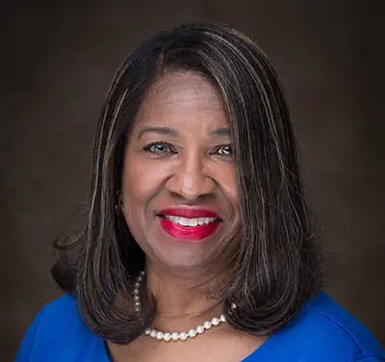
Dr. Sheila Cannon, PhD, PMHCNS-BC/ PMHNP-BC
Dr. Sheila Cannon is the Associate Dean for FSU's SON and is the Program Director. Dr. Cannon is a board-certified Clinical Nurse Specialist in psychiatric mental health (PMHCNS), a Psychiatric Mental Health Nurse Practitioner (PMHNP), and an approved Buprenorphine provider. She is SANE trained and has expertise in trauma-focused cognitive behavior therapy. She has been on the receiving end of many sexual assault victims, and specialized in post-traumatic stress, depression, anxiety, and many other disorders.

Slide 3
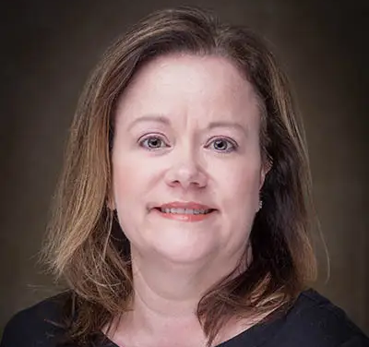
Dr. Sherry Leviner, PhD, RN, CEN, FNP-C
Dr. Sherry Leviner, the co-project lead, is an Associate Professor of Nursing for FSU's SON. She is SANE trained and has previously worked in the emergency department in a SANE capacity. She is a Certified Emergency Nurse (CEN) and Family Nurse Practitioner (FNP-C).

Slide 4
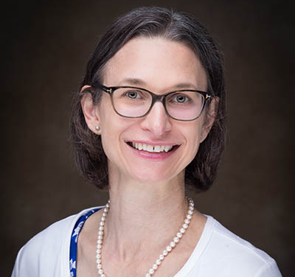
Kim Vogt, MSN, RN
Kim Vogt is the SANE Program Coordinator. She has worked in emergency nursing for over 11 year. She is SANE trained and currently works with a local area emergency department in this capacity.

Slide 5
Educational Consultants/Content Experts

Slide 6
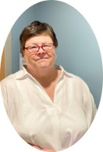
Deborah Flowers, MSN, CPNP-BC, SANE-A, SANE-P
Deborah Flowers is a board-certified Pediatric Nurse Practitioner and has a plethora of knowledge and over 33 years of experience working with sexual assault victims and developing SANE training programs. Ms. Flowers has dual certification for SANE-A and SANE-P. She is the Medical Services Coordinator of the Child Advocacy Centers of North Carolina. Ms. Flowers has vast experience in curriculum development for SANE and started the UNC Chapel Hill SANE program. She is an expert in the scope of practice and IAFN SANE educational guidelines.

Slide 7
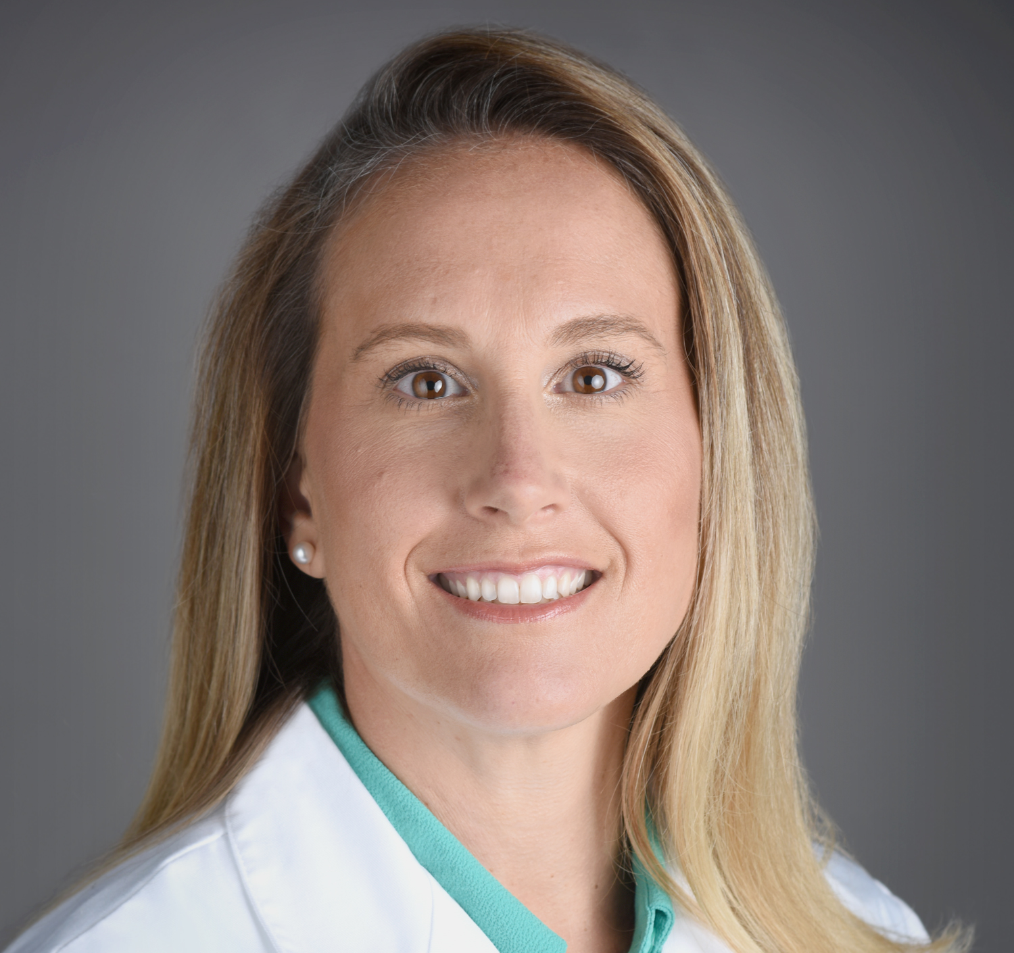
Heather Waleski, MSN, APRN, FNP-C
Heather Waleski is a Family Nurse Practitioner for the Atrium Health Child Protection team. Heather conducts Child Medical Evaluations for children who may have experienced child maltreatment in the form of neglect, physical or sexual abuse, in the outpatient and inpatient setting. Heather has been a Sexual Assault Nurse Examiner since 2008. Heather has conducted Adult and Adolescent SANE trainings in the Charlotte and Monroe areas since 2011.

Slide 8
Presenters/Content Experts
Sergeant Troy Armstrong,
Cold Case Investigations Specialist Public Protection Section
Audrey Dawn B. Proctor, MSN, BSN, AAS, BA, RN, RRT, SANE-A, SANE-P, FNE
Juanita Dudley
Director/Forensic Interviewer
Moore County Children’s Advocacy Center

Slide 9
Presenters/Content Experts
Laurie Mayenschein, BSN, RN, SANE-A
Corrie Jolly, PNP, SANE-A, SANE-P
Samantha Pendergrass, Assistant District Attorney at the Mecklenburg County District Attorney’s Office
Danna M. Hagele MD, MPH
Beth Browning MSN, FNP-C, SANE-A, SANE-P

