Slide 1

WAKE UP WEDNESDAY
Study Hacks
Monica Torres
Writing Center Coordinator
English Instructor

Slide 2

Presenter: Monica Torres
I received my BA and MA in English from California State University, Fullerton (CSUF)
I taught at several CA community colleges and CSUF before moving to NC
I started working at FSU's Writing Center as a Professional Tutor first before becoming an instructor
Now, I am an English Instructor and Temp Writing Coordinator at FSU. In these roles, I continue to assist students in writing and/or basic skills.

Slide 3
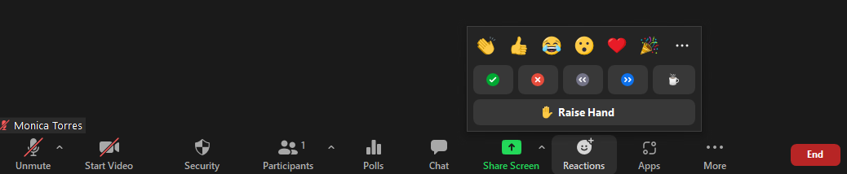
In-Person & Virtual
Mute your mics upon entry
Instructions for Participation

Slide 4
Introductions
What is your major?
What classes are you taking this semester?
What midterm do you have coming up?

Slide 5
Agenda
Introductions
Pre-knowledge/assumptions of learning styles
Lesson
Activity
Conclude

Slide 6
What Do You Know about Learning Styles?
Visual learning
Auditory learning
Kinesthetic learning

Slide 7
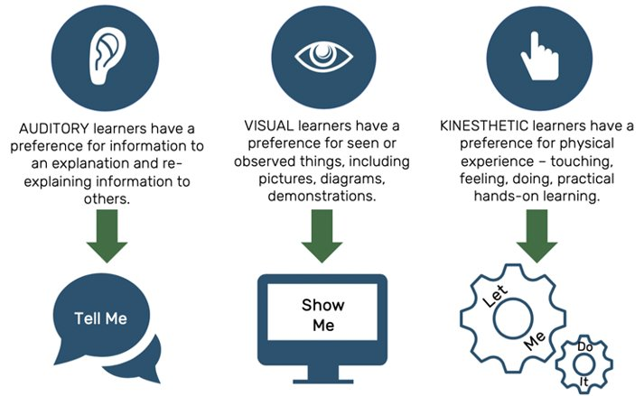
Overview

Slide 8
Visual Learner
Visualize things that you hear
Draw pictures to help explain new concepts
Remember that you need to see things to learn well.

Slide 9
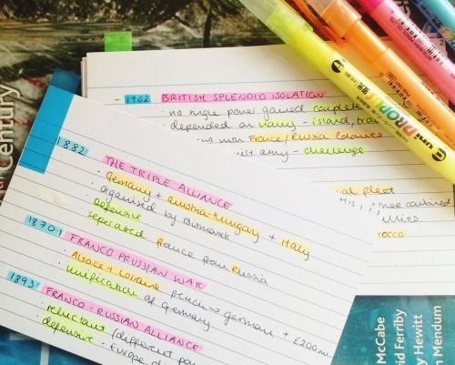
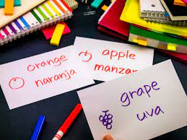
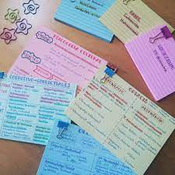
Visual Learner: Studying Hacks
Highlighted flashcards
Colored pens flashcards
Colored flashcards

Slide 10
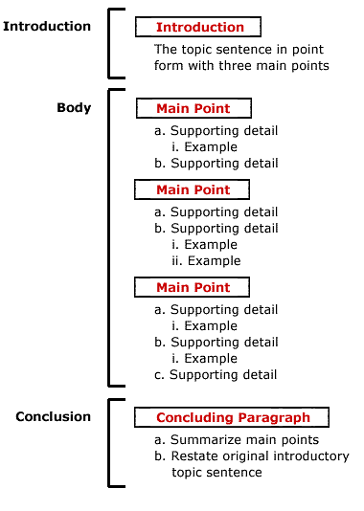
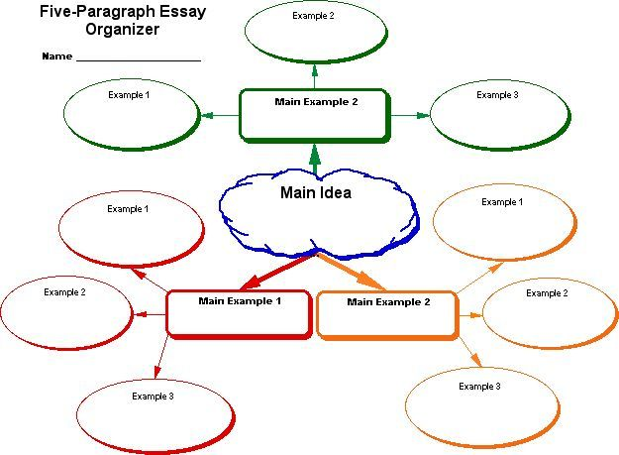
Visual Learner: Studying Hacks
Outlining
Mind-mapping

Slide 11
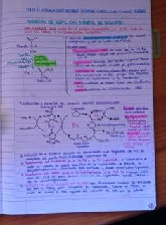
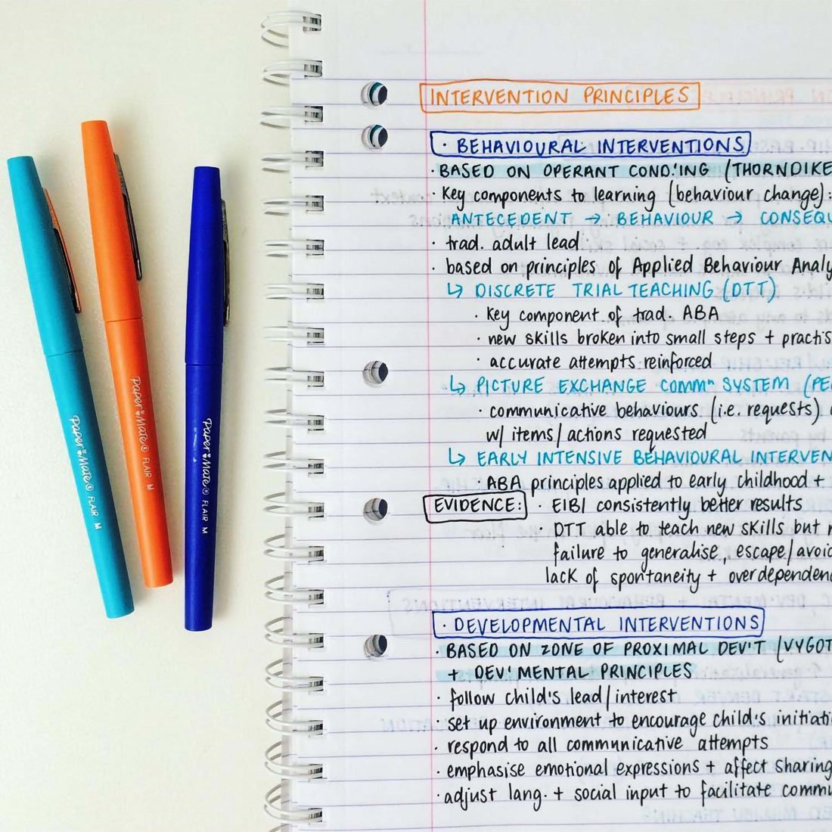
Visual Learner: Studying Hacks
Color-code, highlight, circle, and underline words in your notes and explain it out loud

Slide 12
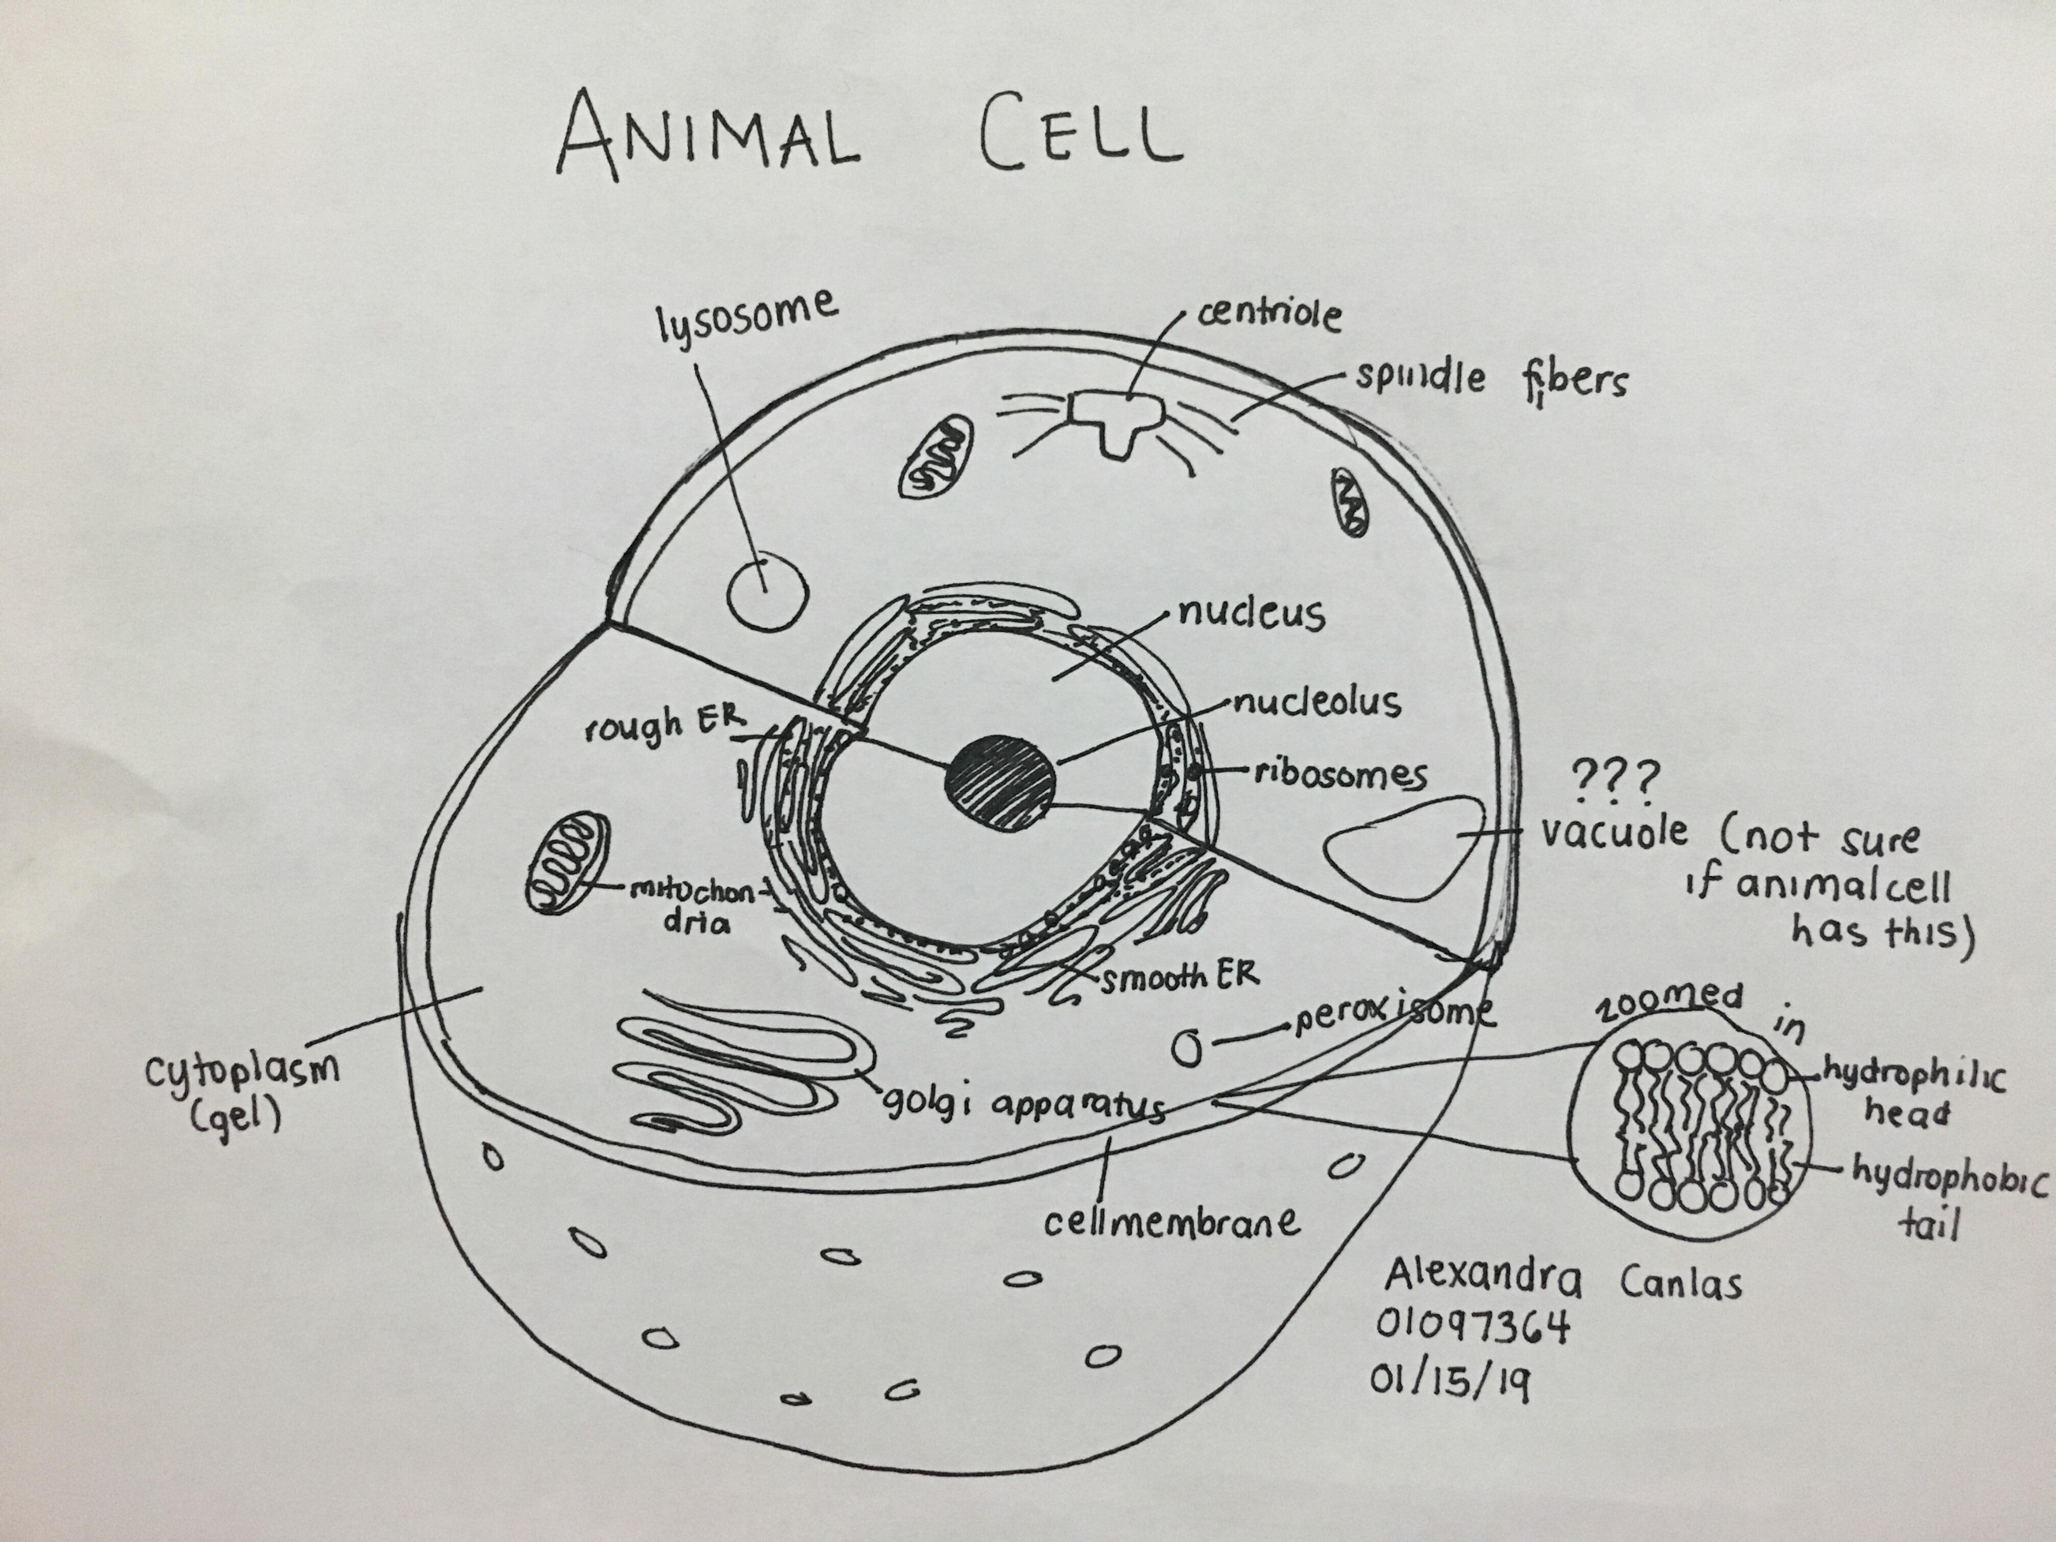
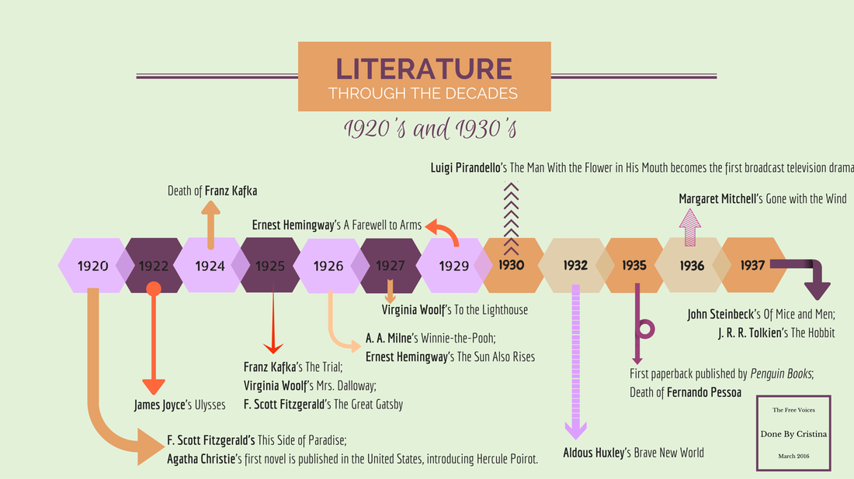
Visual Learner: Studying Hacks
Learn by seeing diagrams, so draw and re-draw concepts
Outline information you need to remember

Slide 13
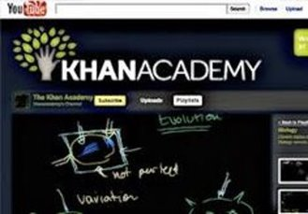



Visual Learner: Studying Hacks
Visualize concepts
Watch videos of concepts
Remember that you need to see things to learn well.​

Slide 14
Auditory Learner
You learn by hearing and listening
Sit where you can hear & use headphones for Zoom
You often learn by speaking it out loud to know it
Remember that you need to hear things, not just see things, in order to learn well.

Slide 15



Auditory Learner: Study Hacks
Use headphones to hear the lessons
Listening to music (like white noise) to focus

Slide 16
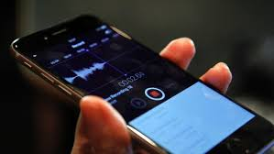
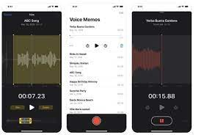
Auditory Learner: Study Hacks
Make an audio recording of your study notes and listen to it on repeat
Record lectures (with your professor's permission)

Slide 17


Auditory Learner: Study Hacks
Talk to someone about what you are learning
Class discussions & study groups

Slide 18

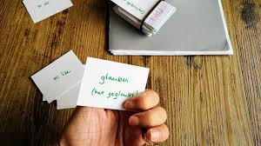
Auditory Learner: Study Hacks
Read everything out loud
Reading your notes/flashcards out loud

Slide 19





Auditory Learner: Study Hacks
Listen to videos that explain the concepts
Pause and repeat videos

Slide 20
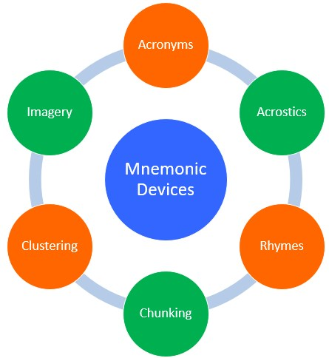
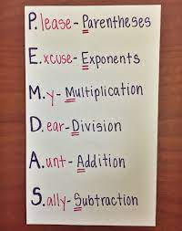
Auditory Learner: Study Hacks
Mnemonic devices to help you remember information

Slide 21
Kinesthetic Learner
You learn by touching and doing, such as physical movement
You are a hands-on learner who prefers to touch, move, build, or draw what you learn
You learn best by doing, not just by reading, seeing, or hearing

Slide 22
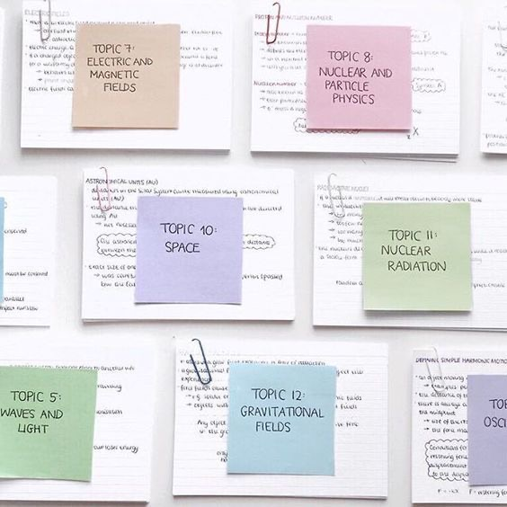

Kinesthetic Learner: Study Hacks
Use flashcards and arrange them in groups
Arrange flashcards around your room

Slide 23
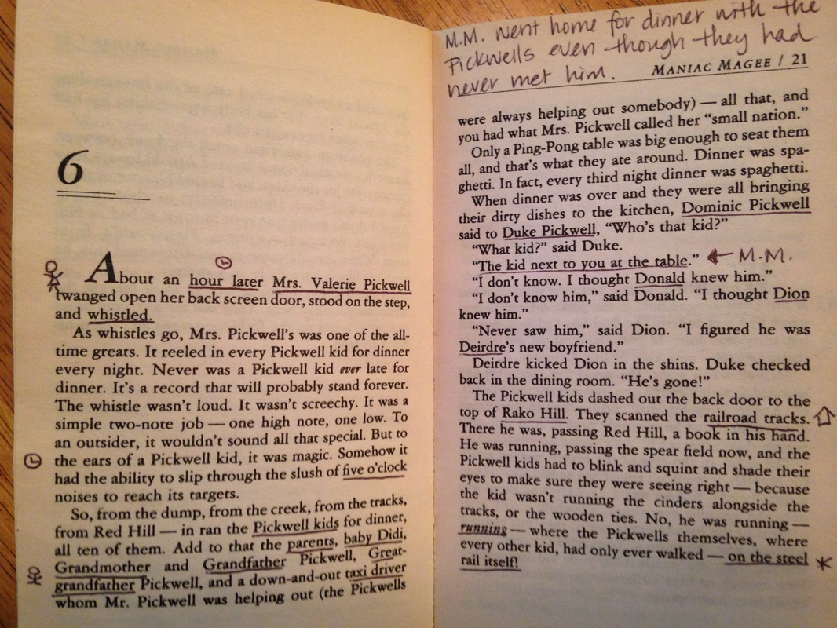
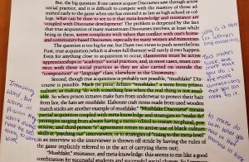
Kinesthetic Learner: Study Hacks
Active reading
React to your text

Slide 24

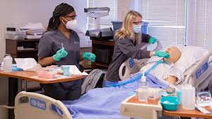
Kinesthetic Learner: Study Hacks
Participate in labs, volunteer, or field trips
Attend conferences for hands-on experience

Slide 25
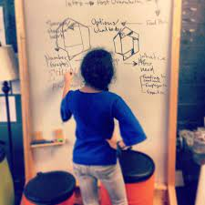

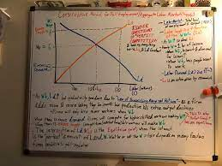
Kinesthetic Learner: Study Hacks
Re-write your notes several times

Slide 26
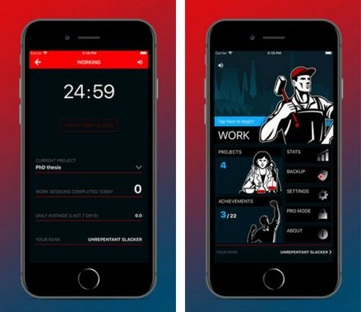
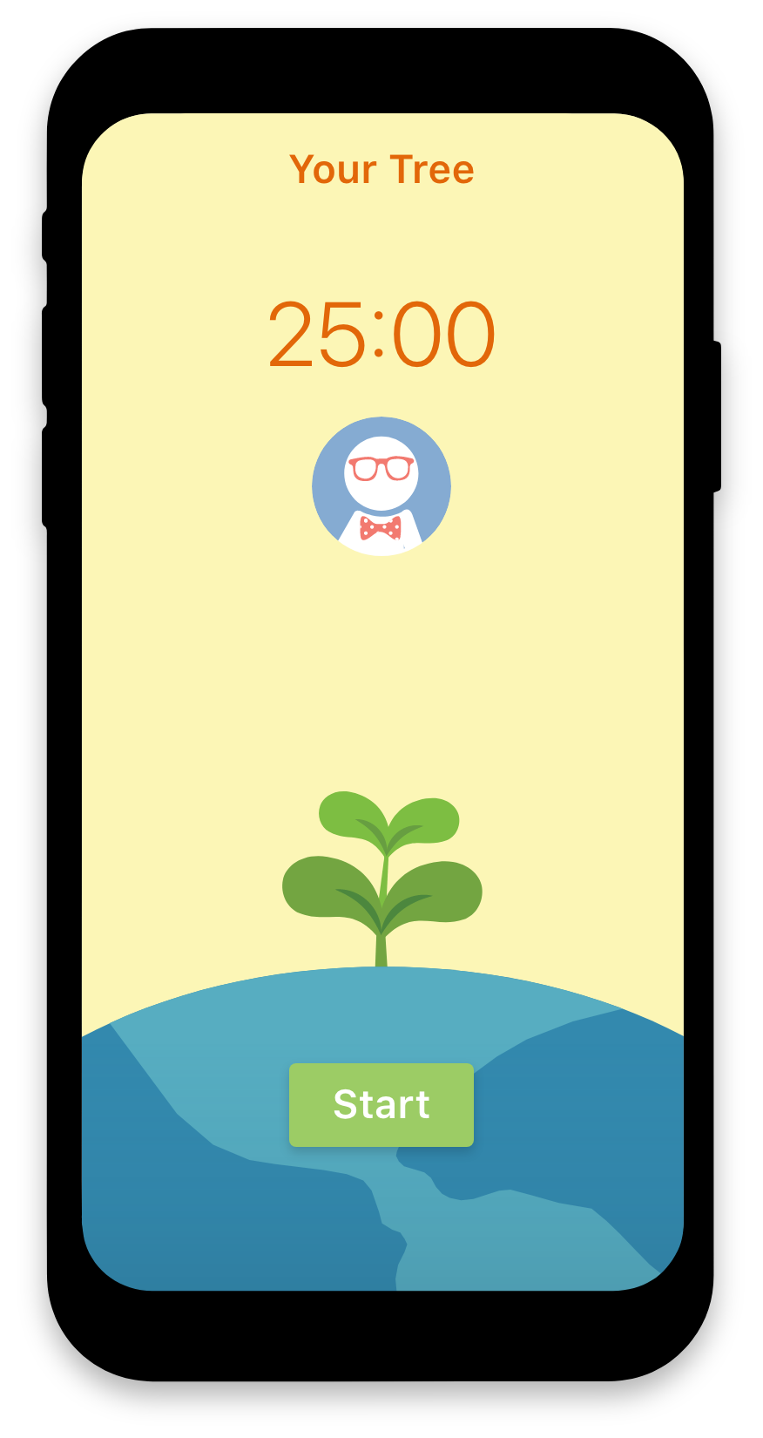
Kinesthetic Learner: Study Hacks
Study in short blocks, so you can take frequent breaks
Use a productivity challenge app

Slide 27
Get Active!
What upcoming midterm(s) do you have?
With your upcoming midterm, what is one way to study using your preferred learning styles technique?
In other words, how do you plan to use this to study smarter, not harder?

Slide 28
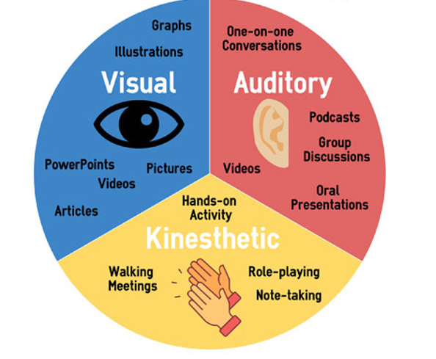
Conclusion
Today, we talked about visual, auditory, and kinesthetic learning and how to study with these learning types
Handout provided

Slide 29

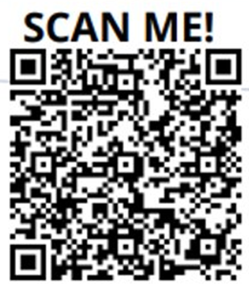
Questions

Slide 30


Slide 31
THANK YOU
Fayetteville State University
Student Success Learning Center
Monica Torres
Writing Center Coordinator & English Instructor
Mtorres7@uncfsu.edu

