Slide 1

Nanosensor Research at FSU
Zhiping Luo, Daryush Ila
1. Rare-earth (RE³⁺) codoped BaSiF₆ and BaGeF₆ nanowires
  Synthesis of BaSiF₆ and BaGeF₆ nanowires
  Characterization by photoluminescence (PL) and cathodoluminescence (CL)
  Fast luminescence property
  Application of BaGeF₆ nanowires in H₂O₂ sensing
2. Rare earth (RE³⁺) doped BaWO₄ nanofibers
  Fabrication of porous nanofibers through electrospinning
  Characterization by PL and CL
  Application in highly sensitive explosive detection
FSU IMREL

Slide 2
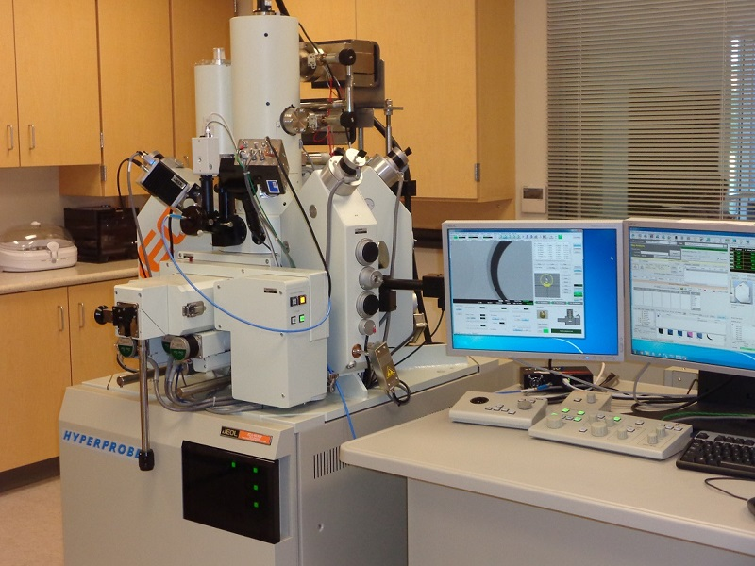
Research Capacity at FSU
The Electron Probe Microanalyzer (EPMA) was funded by ARO in $1.4M in 2009;
The new EDS detector for chemical analysis was funded by ARO in $54K in 2015;
The cathodoluminescence was funded by NSF MRI program in $201K in 2016;
The EPMA instrument at FSU is the unique instrument with field-emission source in North Carolina and neighboring states.
JXA-8530F EPMA at FSU (indicated are CL funded by NSF MRI).
FSU IMREL

Slide 3
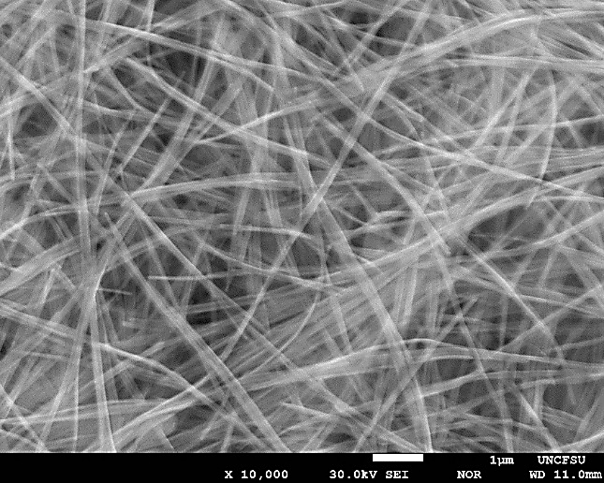
BaSiF₆ Nanowires
(d)
1 μm
Photoluminescence (PL)
Cathodoluminescence (CL)
Superlong BaSiF₆ nanowires are synthesized (35.8 nm in diameter and 10–50 μm in length);
Strong emissions are obtained in PL and CL;
The decay time shows subnanosecond fast luminescence property.
G. George et al., J. Mater. Chem. C 6, 7285–7294 (2018).
Decay time
FSU IMREL

Slide 4
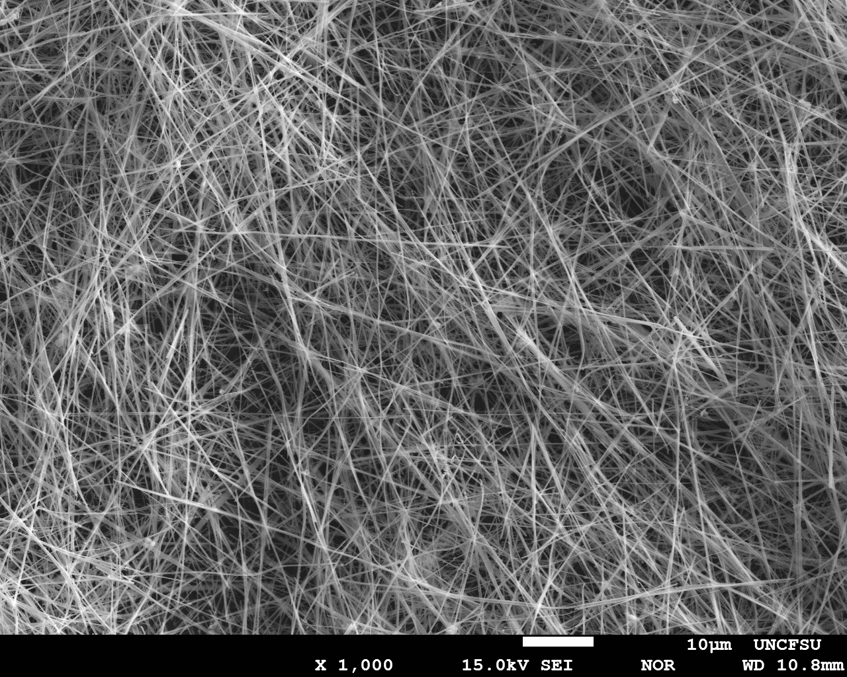
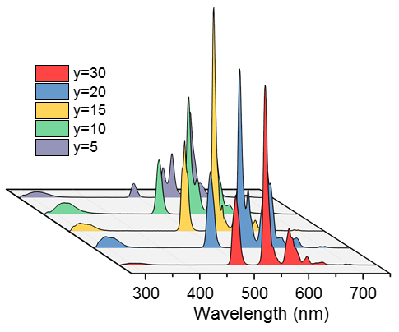
BaGeF₆ Nanowires
(d)
10 μm
Sensitive detection of H₂O₂
H₂O₂ Detection
Superlong BaGeF₆ nanowires are synthesized (58 nm in diameter and 50–100 μm in length);
Strong emissions are obtained;
The BaGeF₆ nanowires can be used as luminescence probe for sensitive detection of H₂O₂ (25 ppm).
G. George et al., RSC Adv. 8, 39296-39306 (2018).
Photoluminescence
FSU IMREL

Slide 5
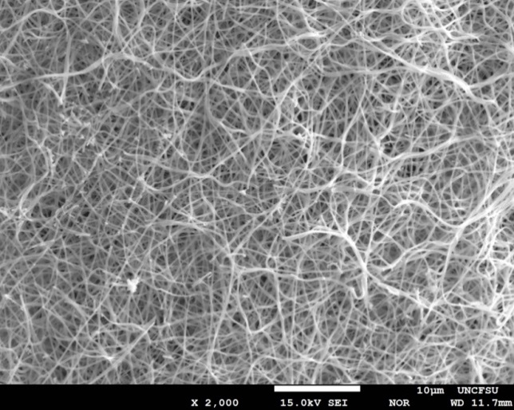
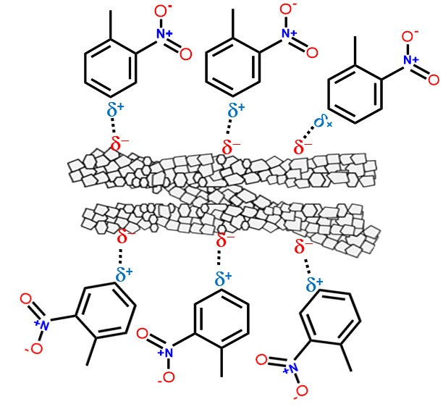
BaWO₄ Nanofibers
(d)
Sensitivity
Detection
BaWO₄ nanofibers were synthesized by electrospinning;
Highly selective towards aromatic nitro-compounds and H₂O₂, with the sensitivity within the range of 1–400 ppb and 1–10 ppm, respectively.
G. George et al., J. Mater. Chem. C 7, 14949–14961 (2019).
Mechanism
FSU IMREL

Slide 6
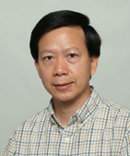
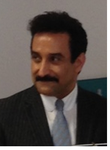
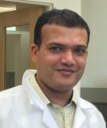
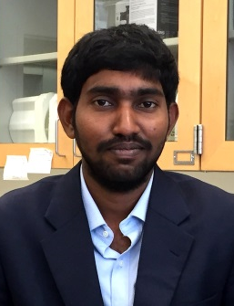
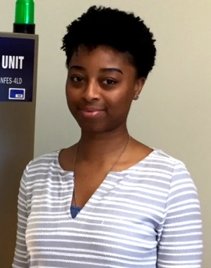
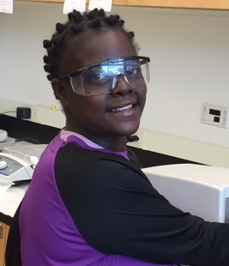
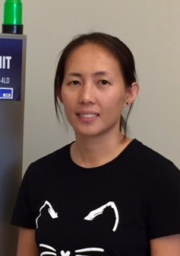
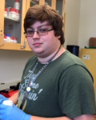
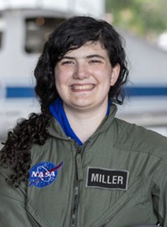
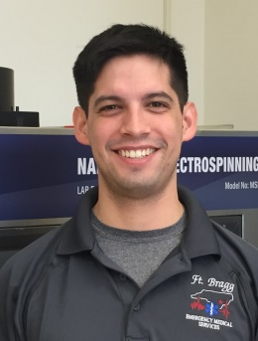
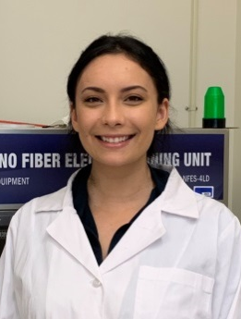
Group Members
Dr. Zhiping Luo
Project PI
Dr. Daryush Ila
Co-PI
Dr. Gibin George
Postdoc Fellow
Dr. Sivasankara Ede
Postdoc Fellow
Candyce
Collins
Caressia
Edwards
Jessa
Guffie
Jacob
Hayes
Lenore
Miller
Carlos
Posada
Aspyne
Silvestro
FSU IMREL

